Slide 1


Slide 2

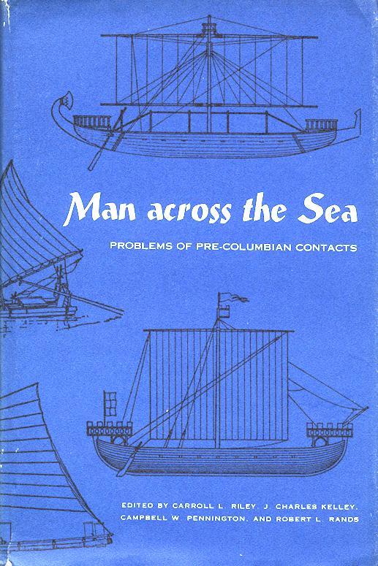
New York, 1947
Austin, 1971

Slide 3
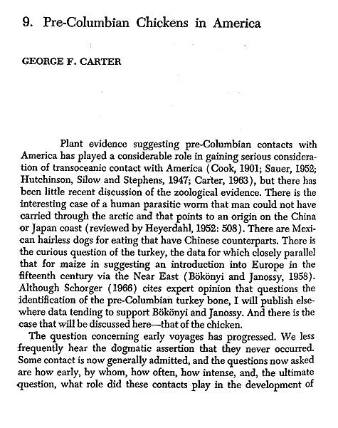


El Arenal, Chile
(1321-1404)

Slide 4
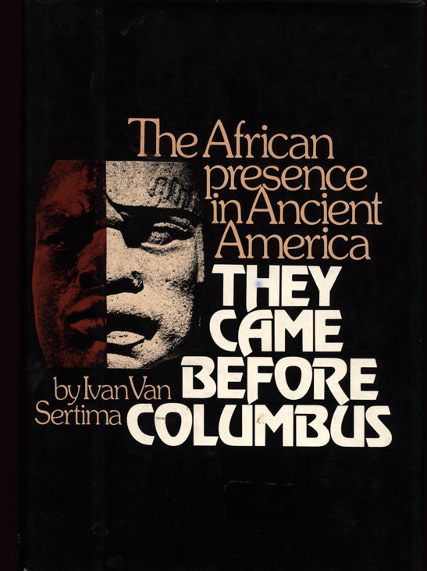
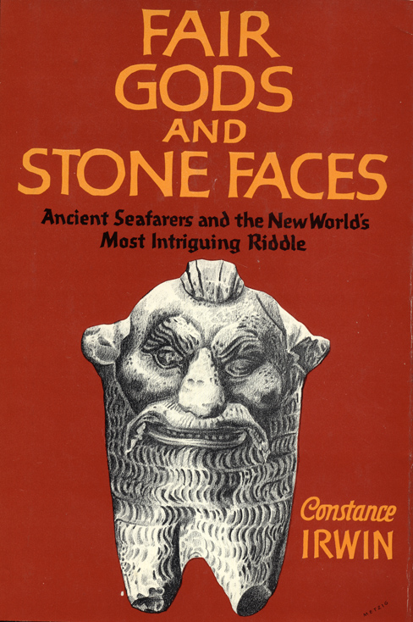

Slide 5
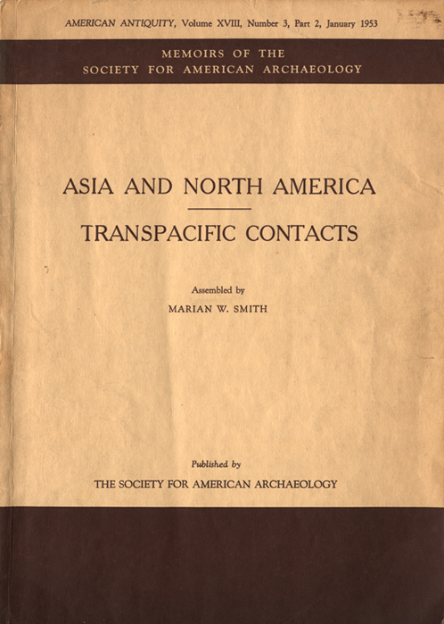
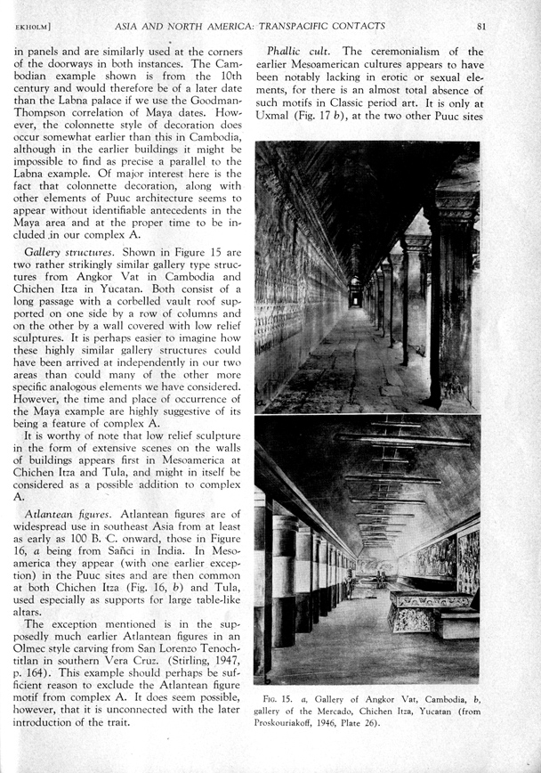
Gordon F. Ekholm
(1909-1987)

Slide 6
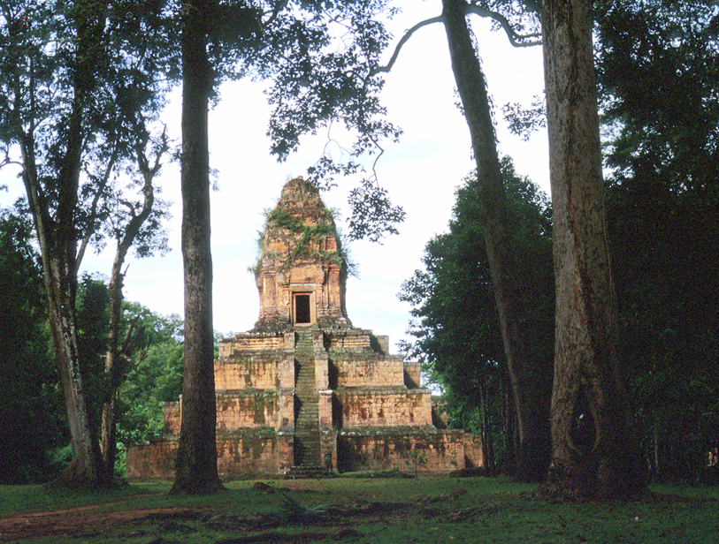
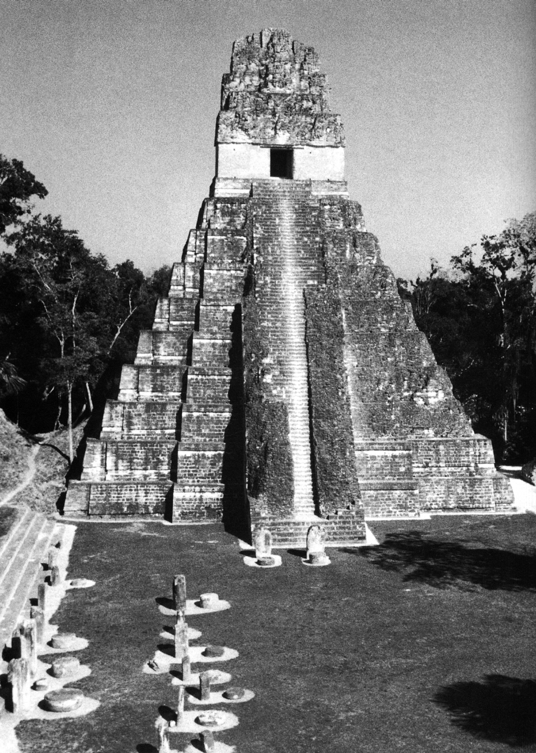
Temple I, Tikal
Baksei Chamkrong, Angkor

Slide 7
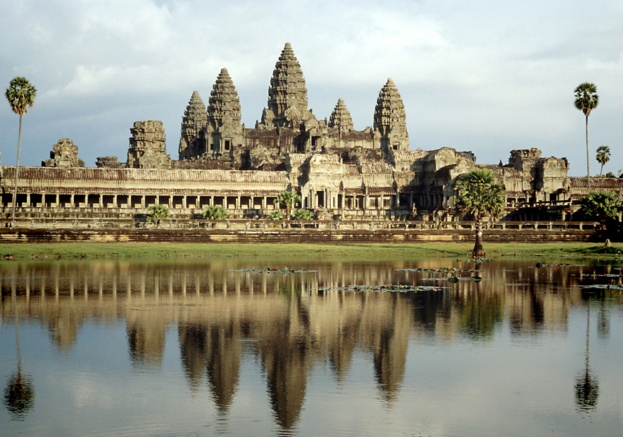
ANKOR WAT

Slide 8
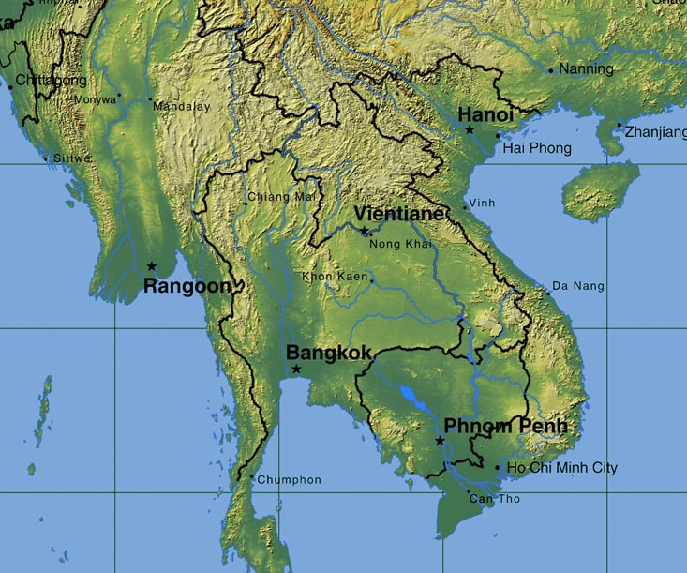
China
Myanmar
Laos
Thailand
Vietnam
Cambodia

Slide 9
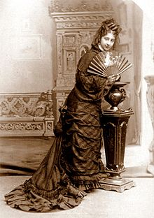
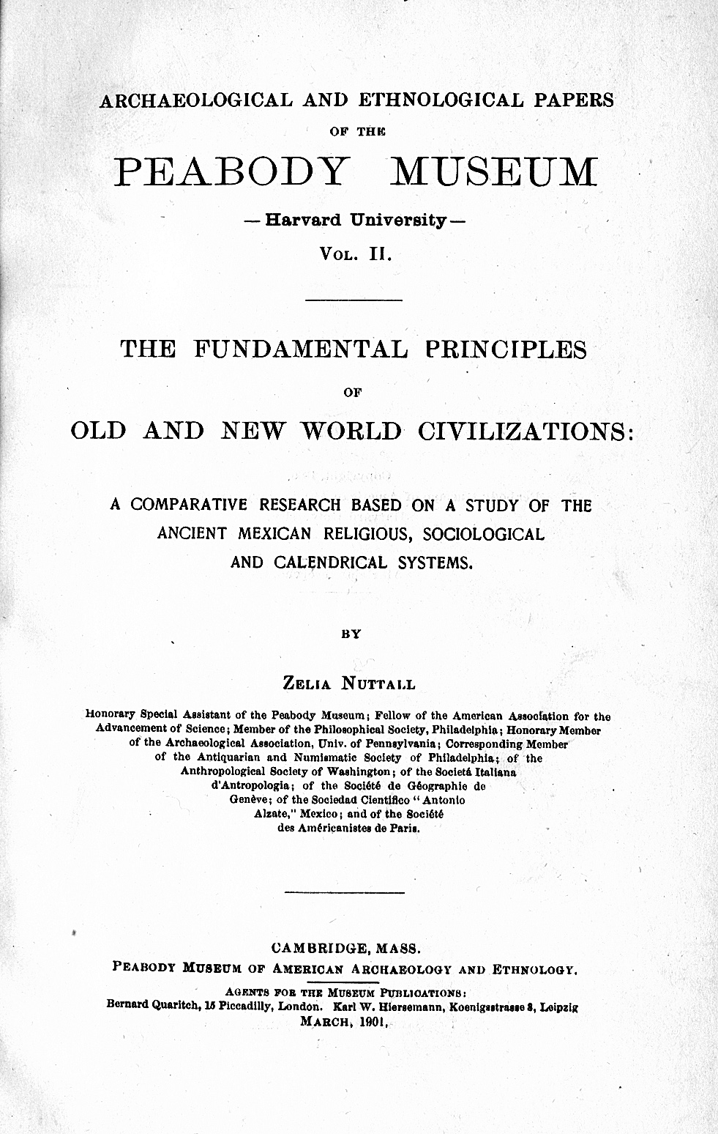
Zelia Nuttall (1857-1933)

Slide 10
Color-directions
In Asia and the
Americas

Slide 11
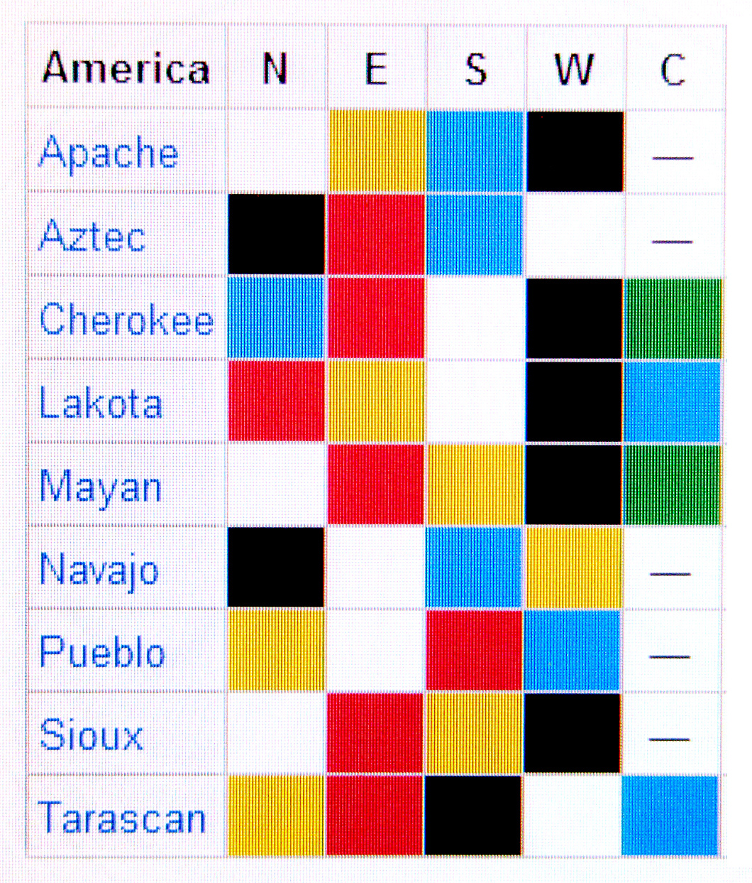
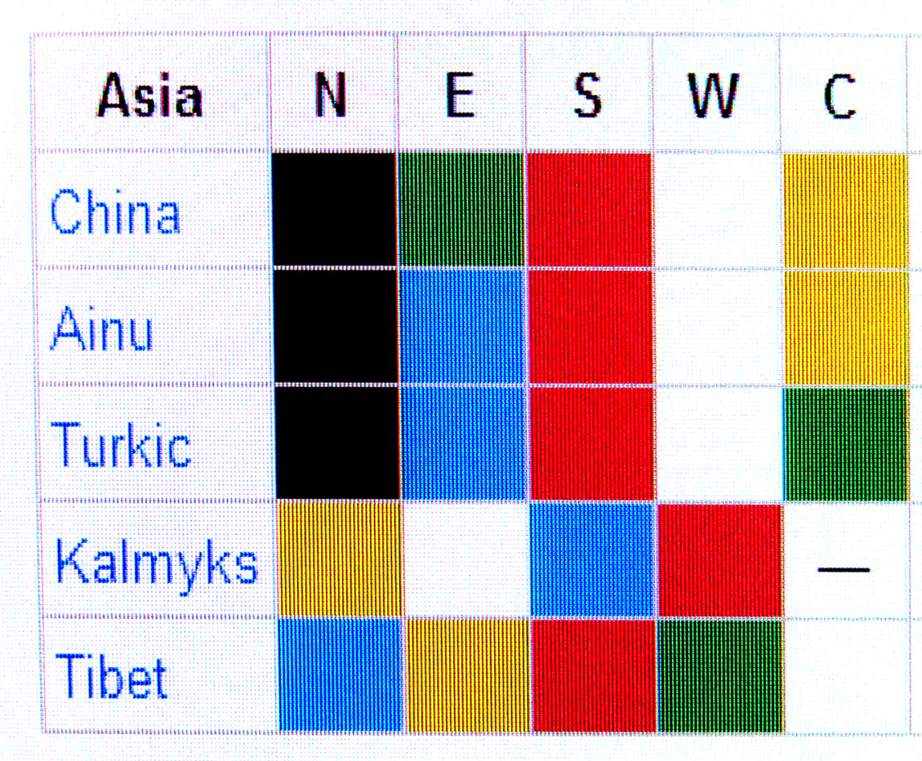

Slide 12
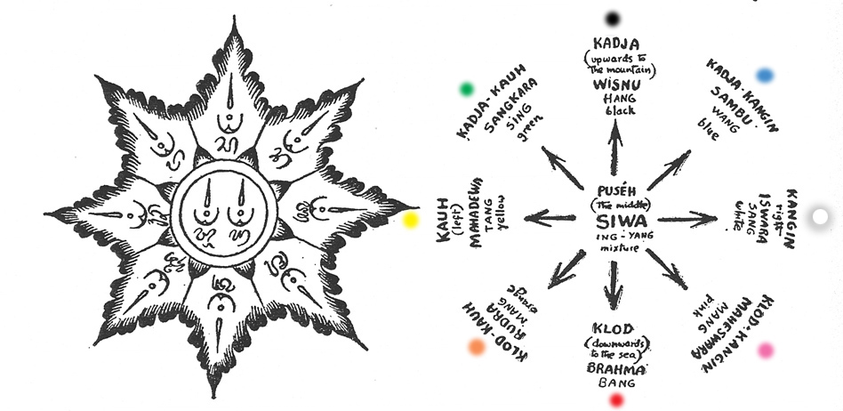
Miguel Covarrubias: Island of Bali

Slide 13
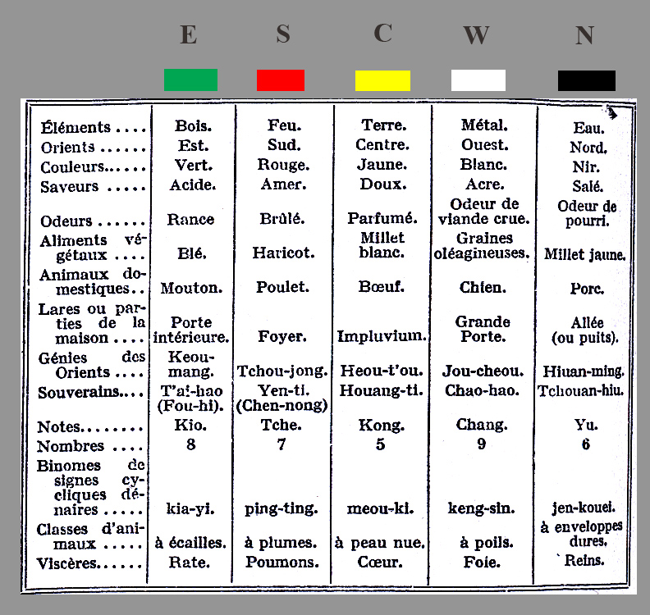
60-year
cycle
Marcel Granet: La Pensee Chinoise (1950)

Slide 14
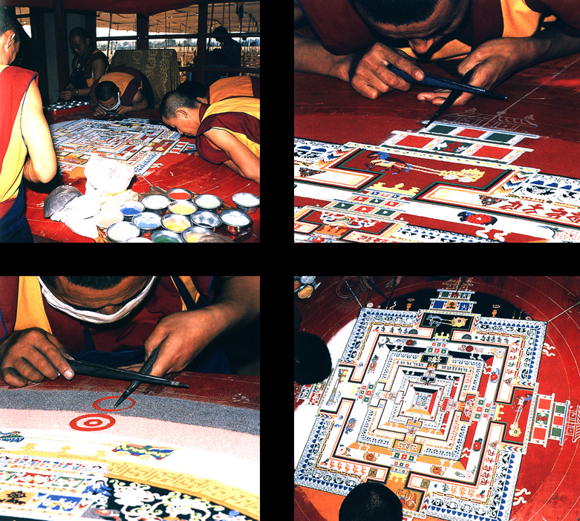
Tibetan Sand Mandala – Dharamsala, India

Slide 15
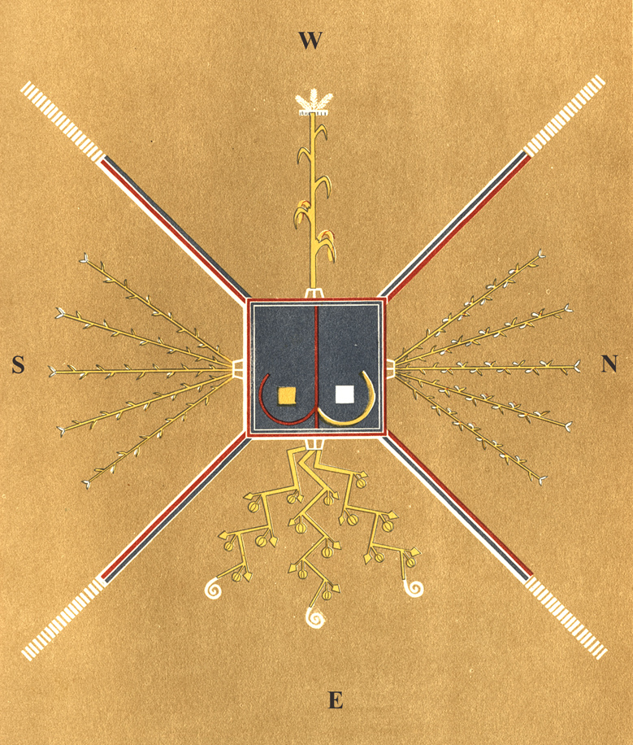

Slide 16
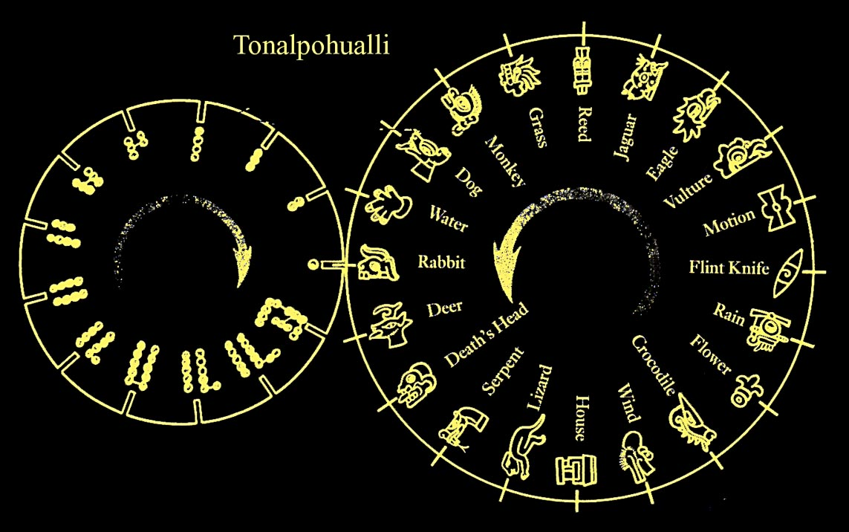

Slide 17
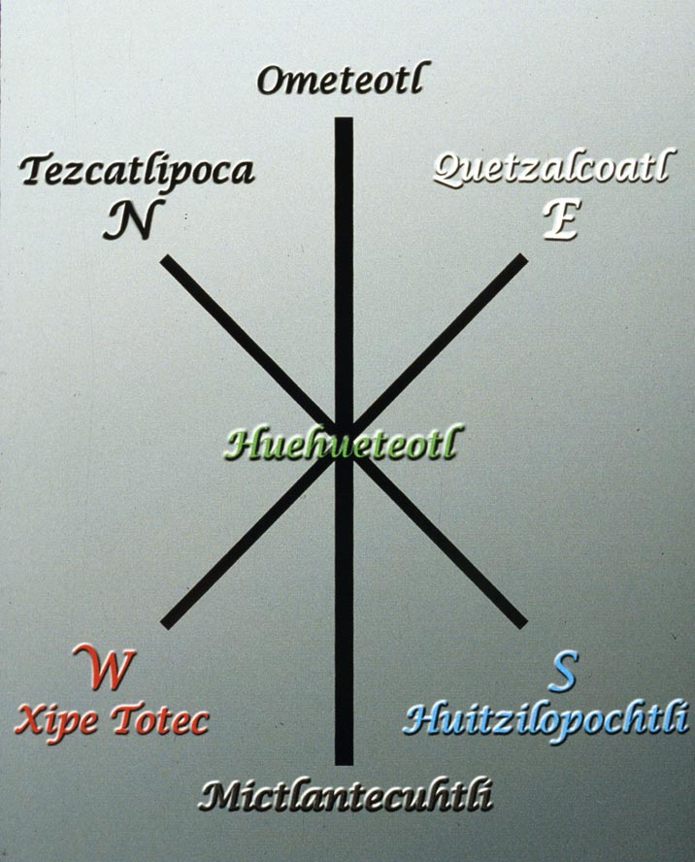
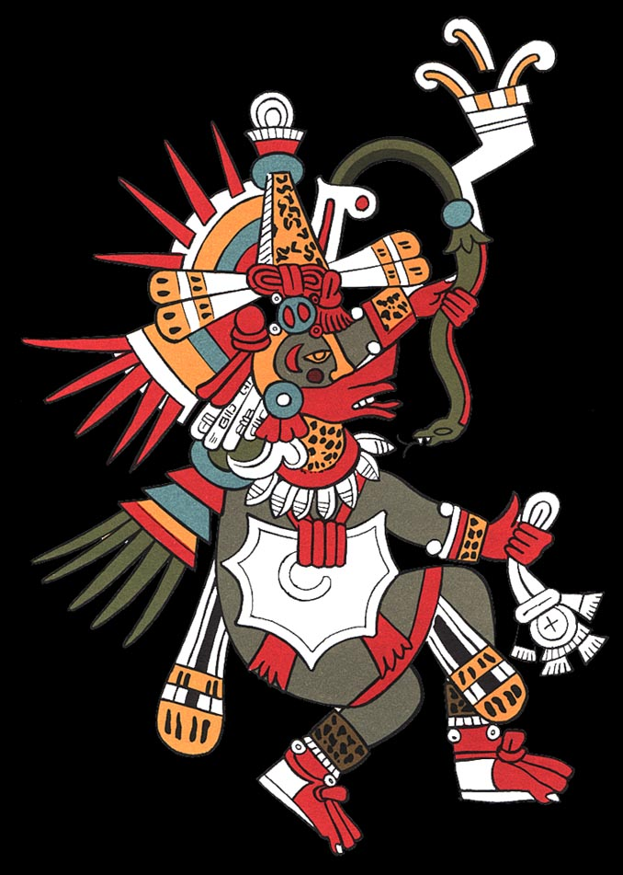
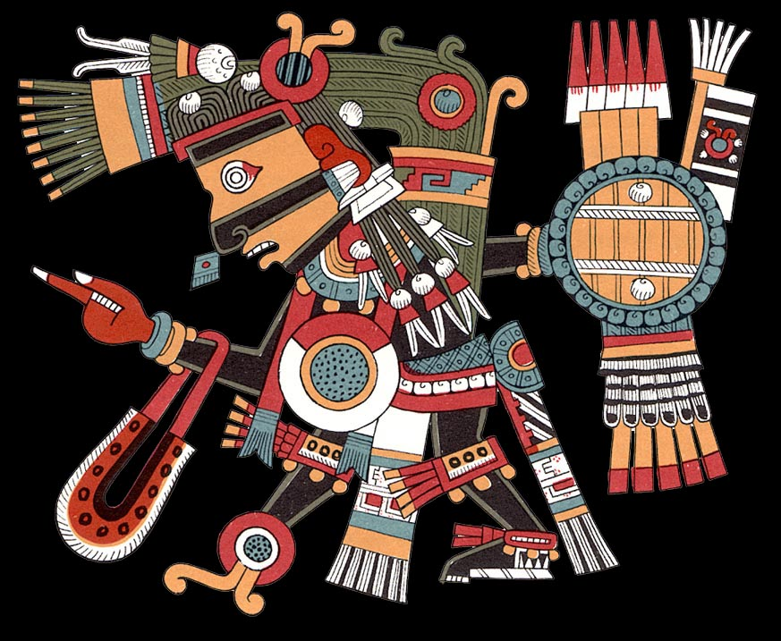
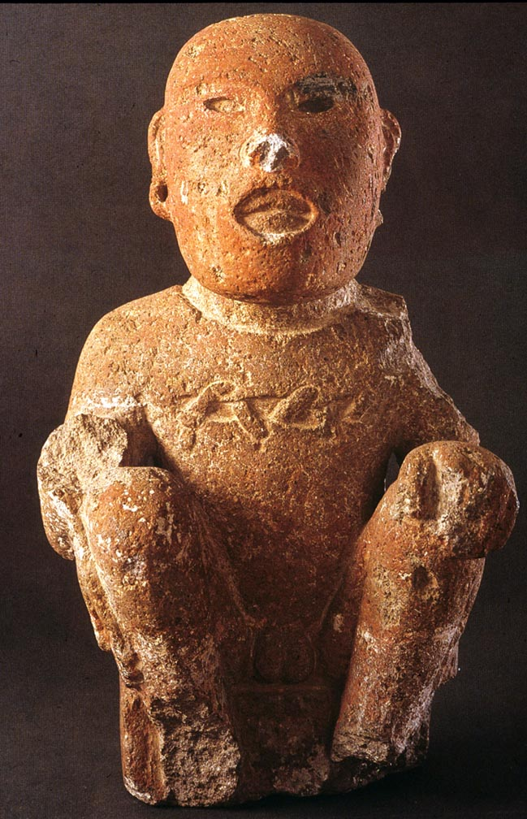
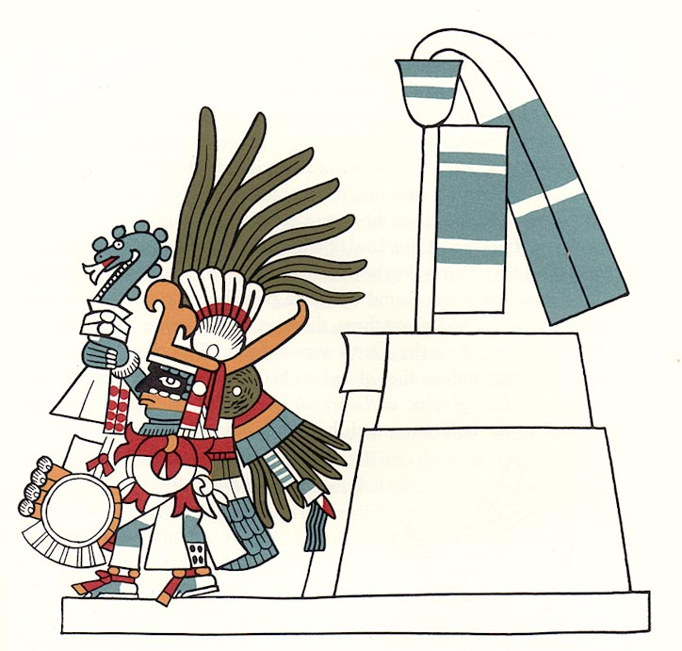

Slide 18
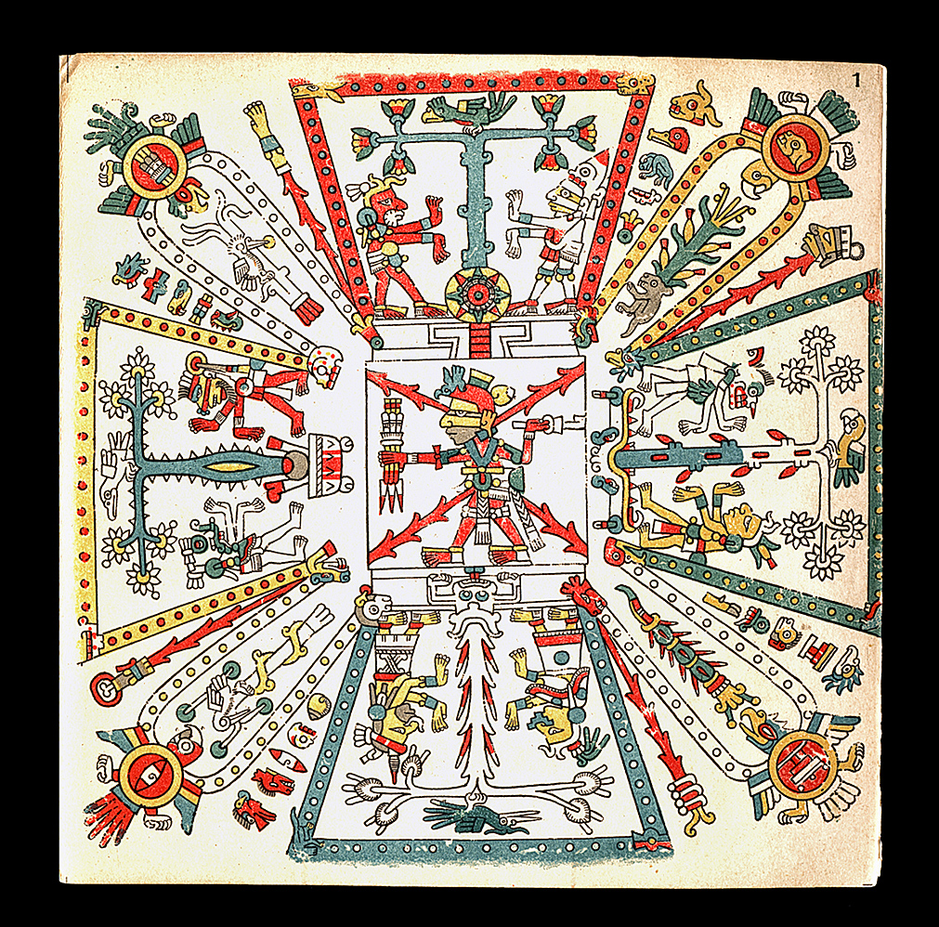
E
N
S
W

Slide 19
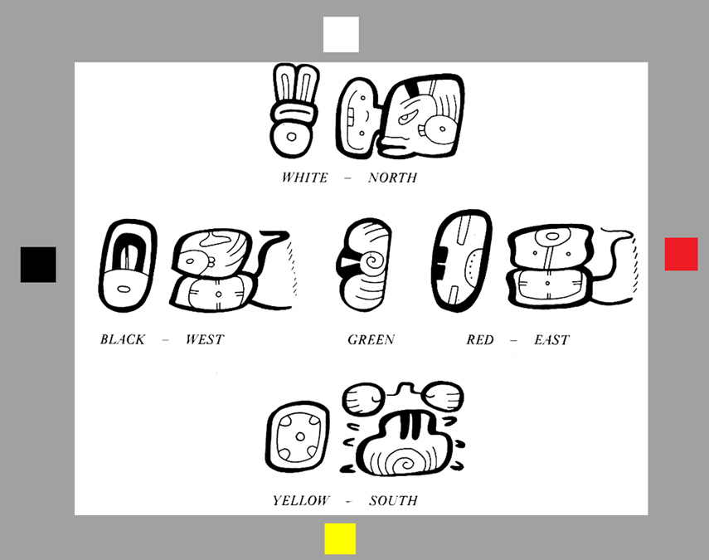

Slide 20
THE ISLAND
OF
BALI

Slide 21
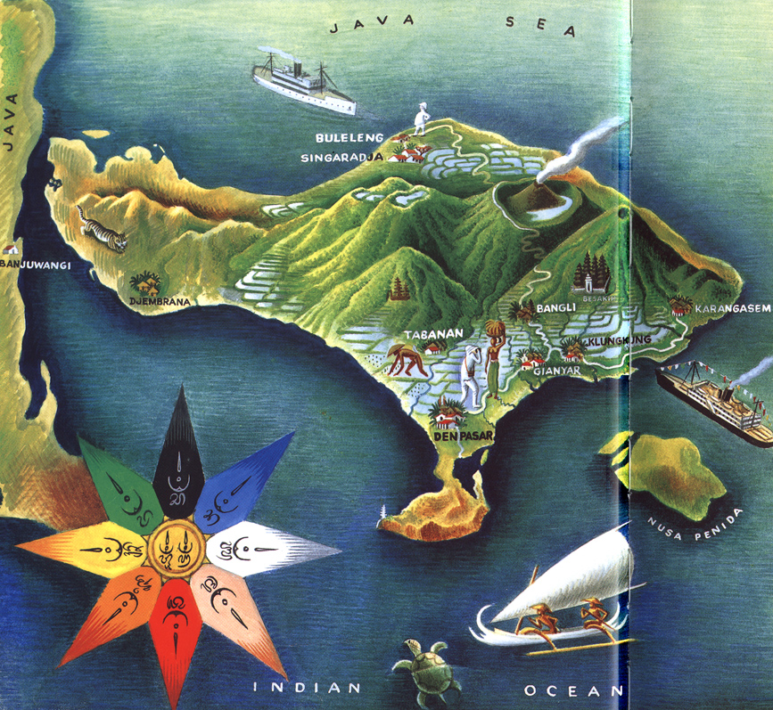

Slide 22
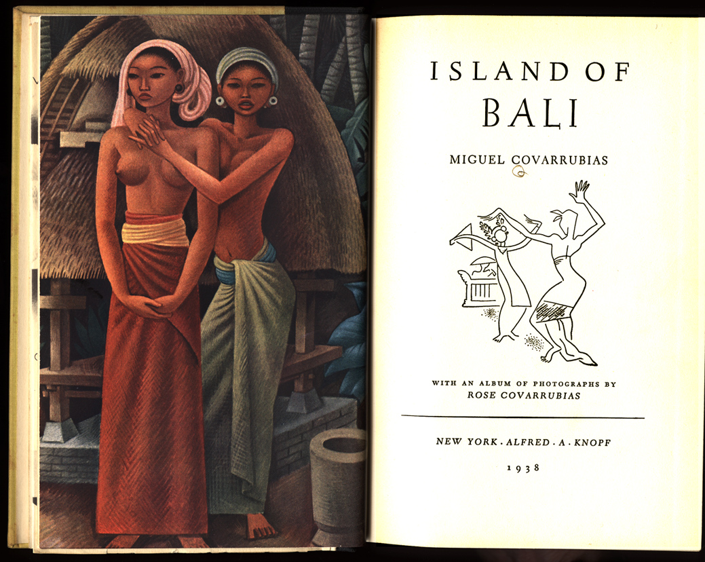

Slide 23

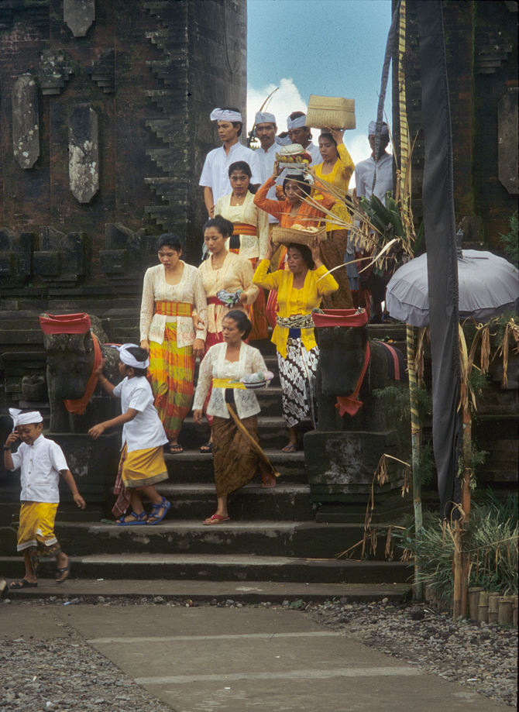
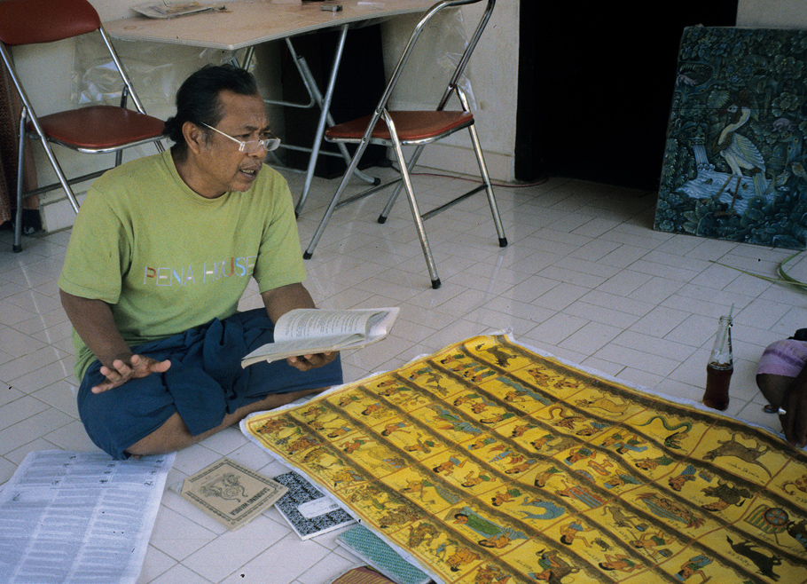

Slide 24
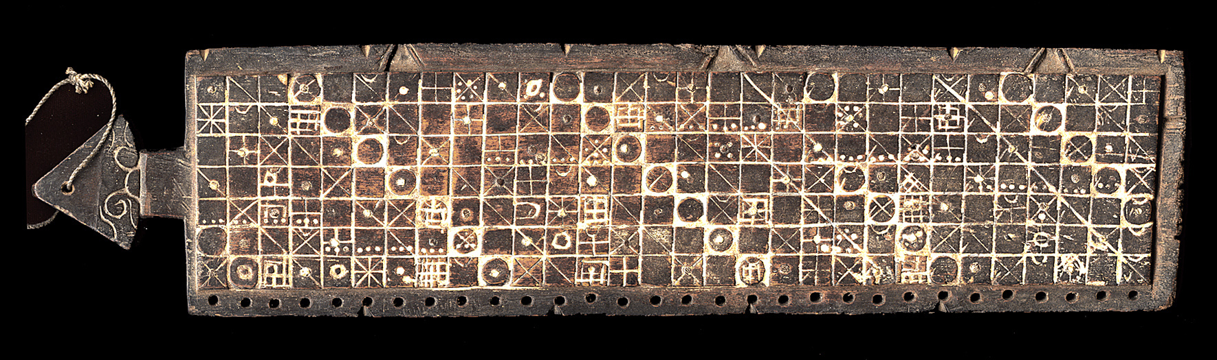
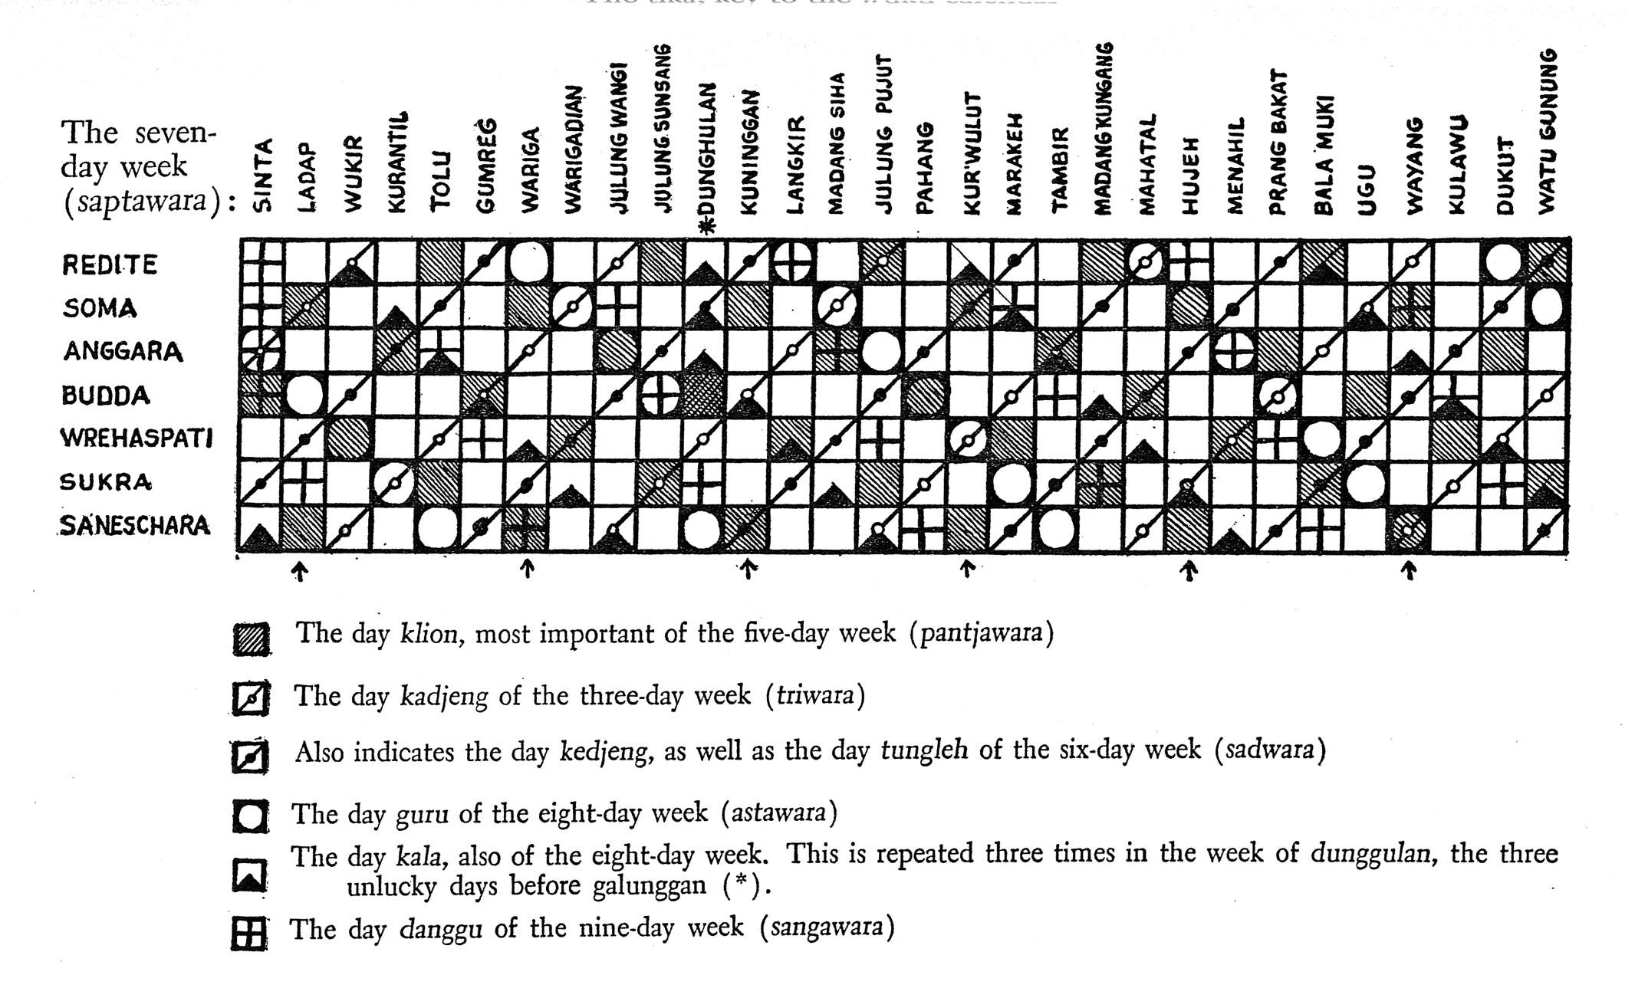

Slide 25
BALI – COLOR DIRECTIONS

Slide 26
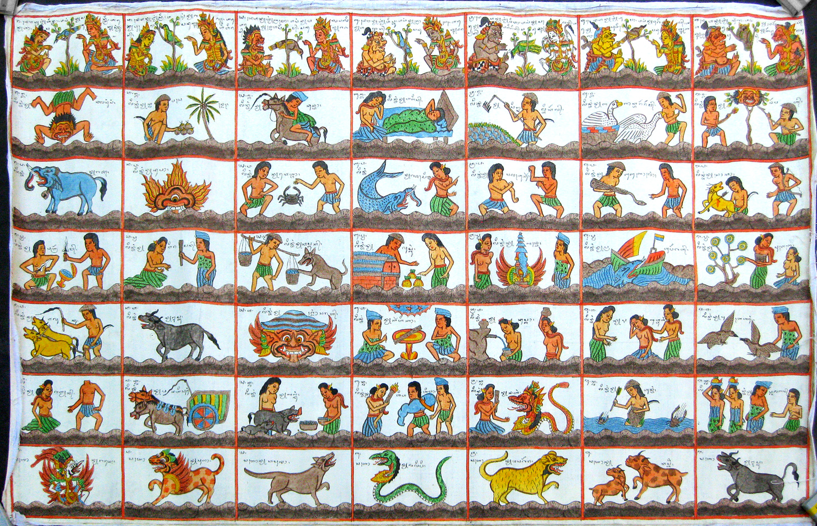

Slide 27
Bark Paper Books

Slide 28
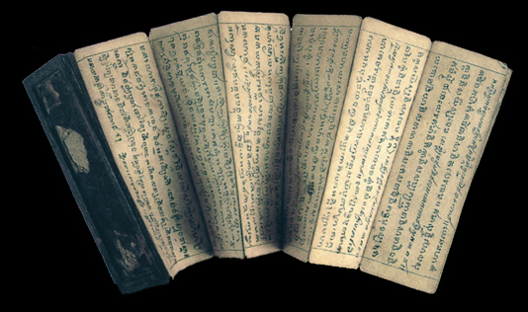
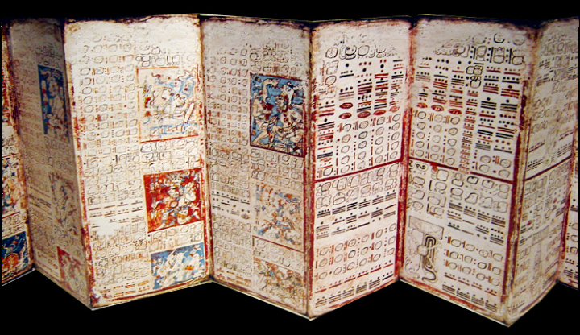
Cambodia
Yucatan
Yucatan

Slide 29
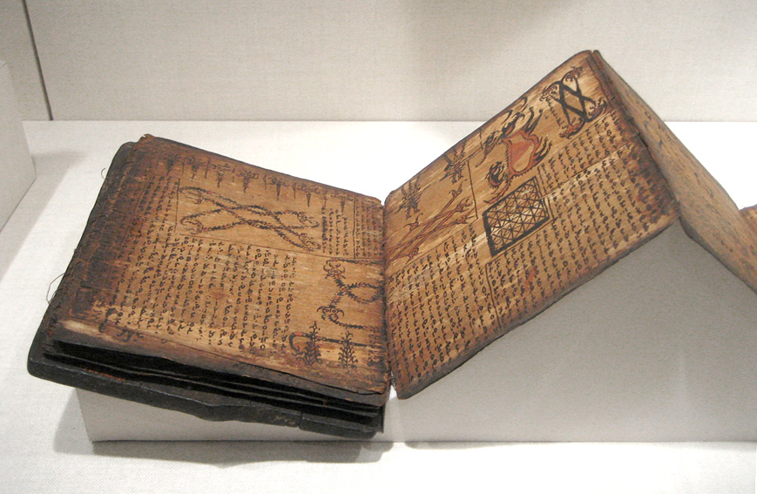
Batak, Sumatra

Slide 30
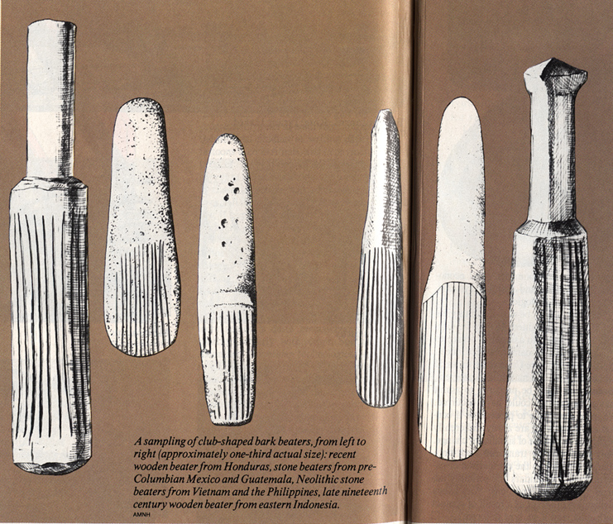
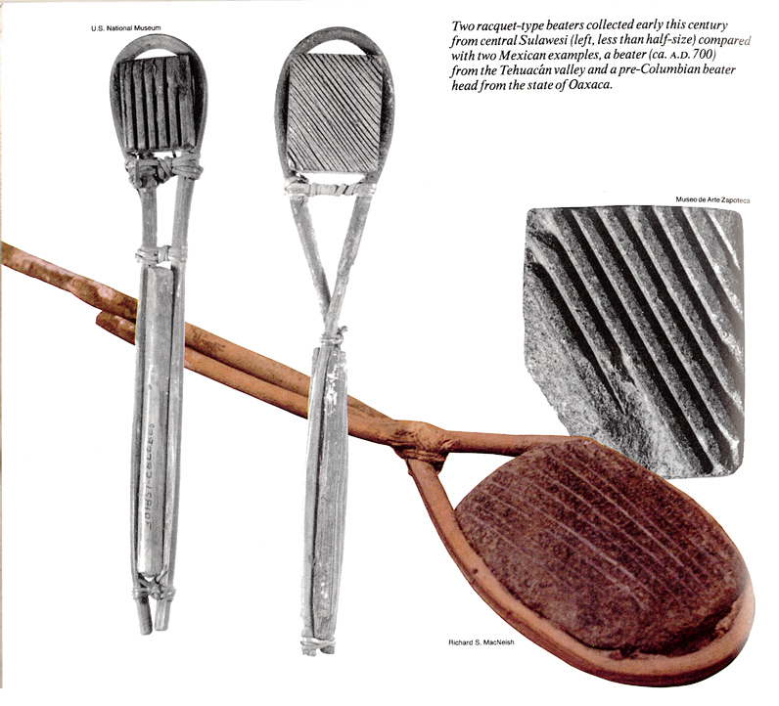
Paul Tolstoy: “Paper Route”
Natural History, June 1991

Slide 31
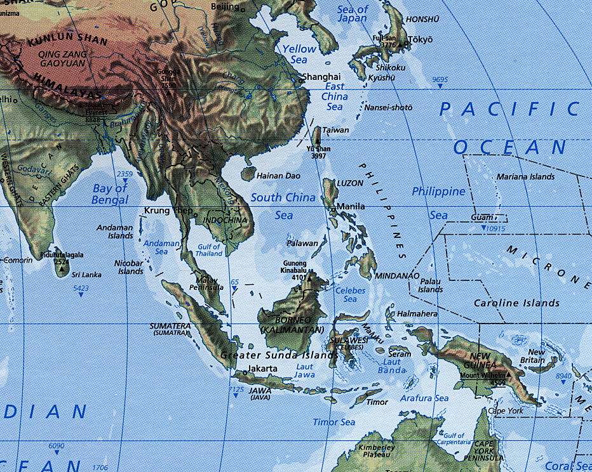

Slide 32
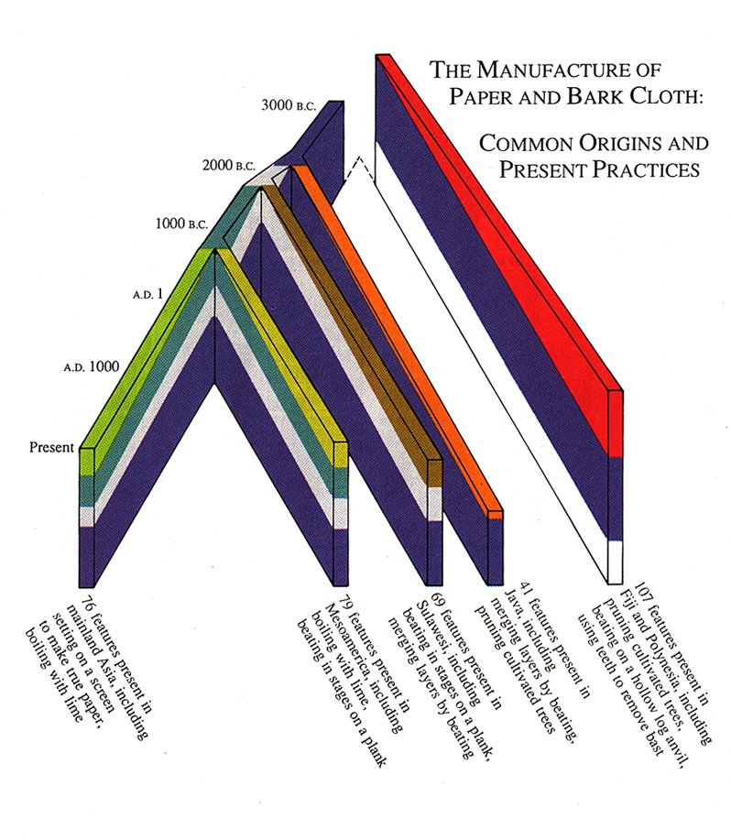

Slide 33
Astronomy

Slide 34
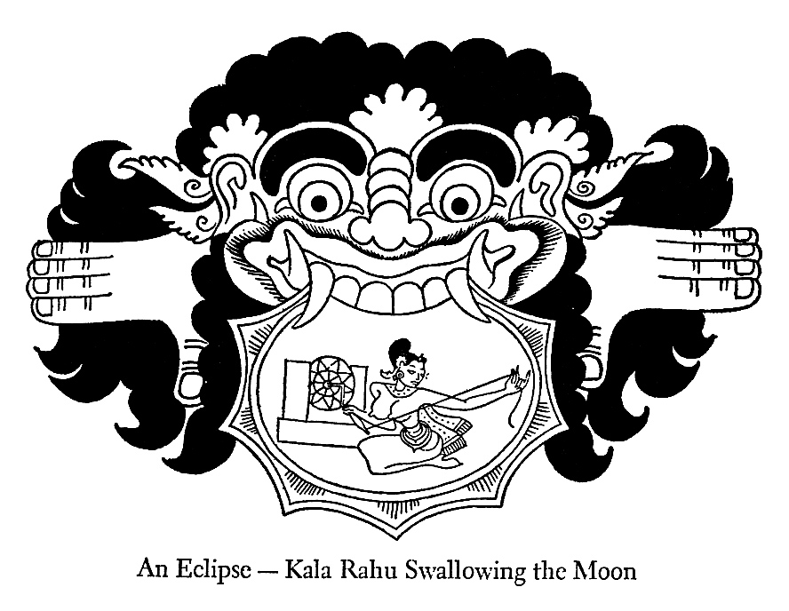
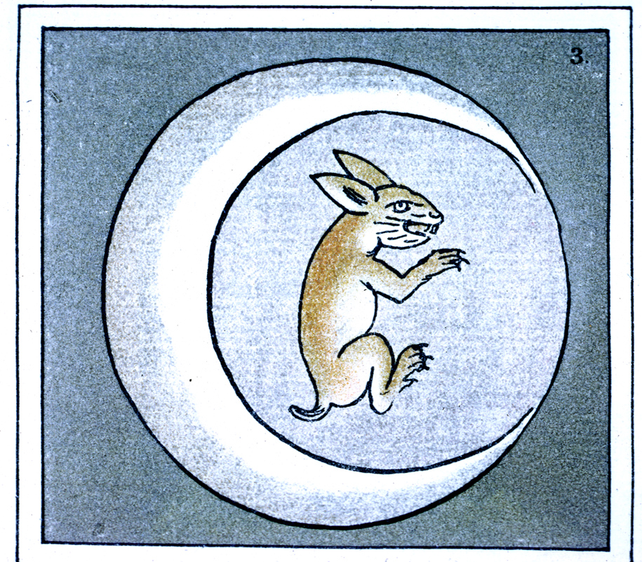
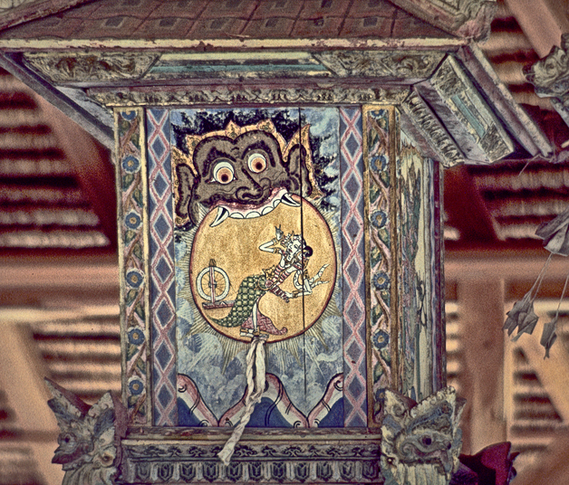
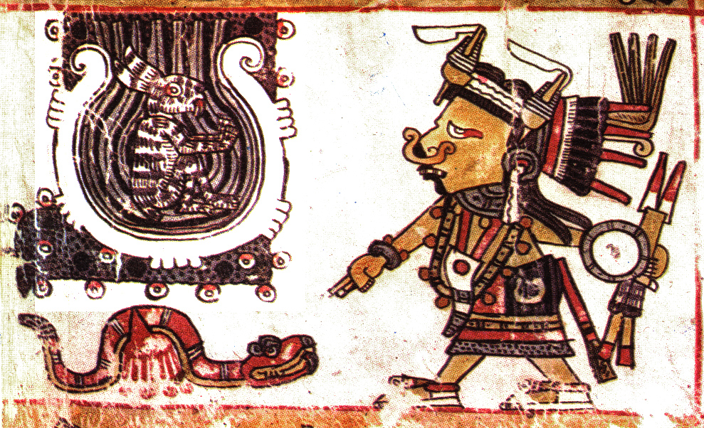
Aztec (Sahagun)
Bali
Borgia Codex

Slide 35
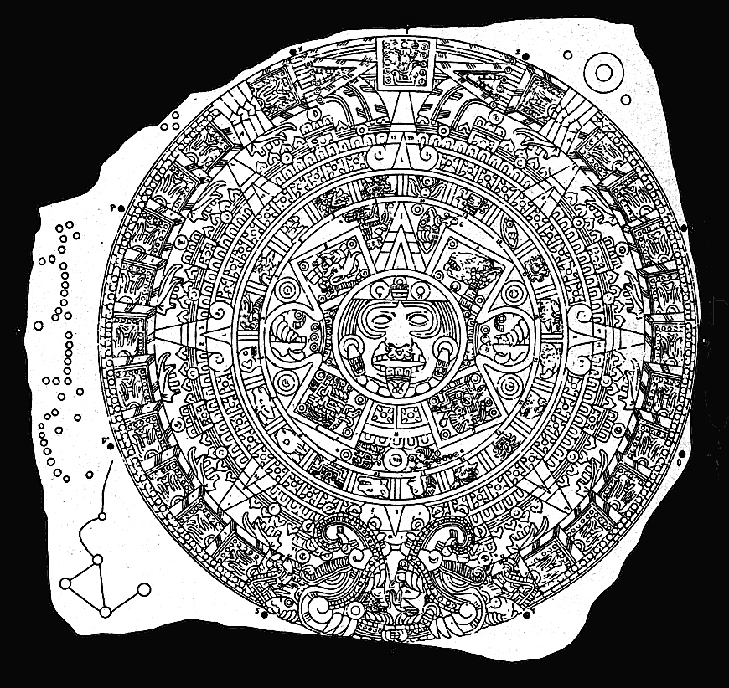
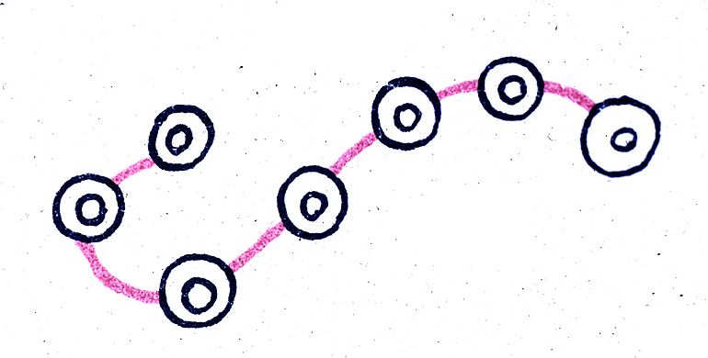
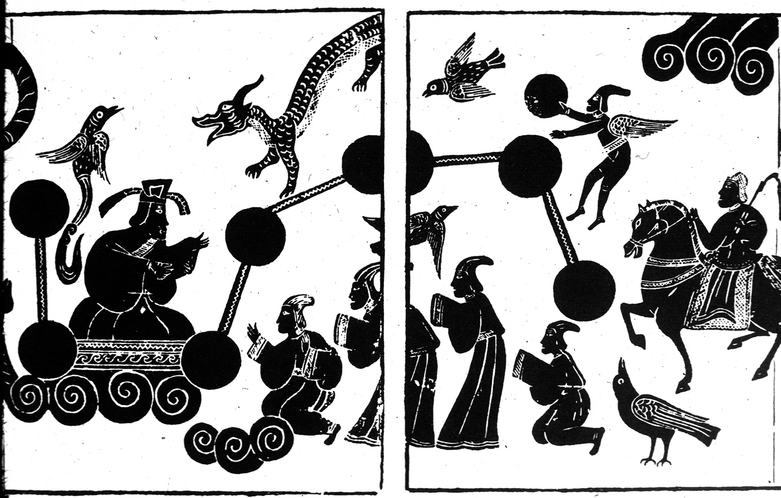
Xonecuilli (Sahagun)
Aztec Calendar Stone (Nuttall)
Han Dynasty tomb

Slide 36
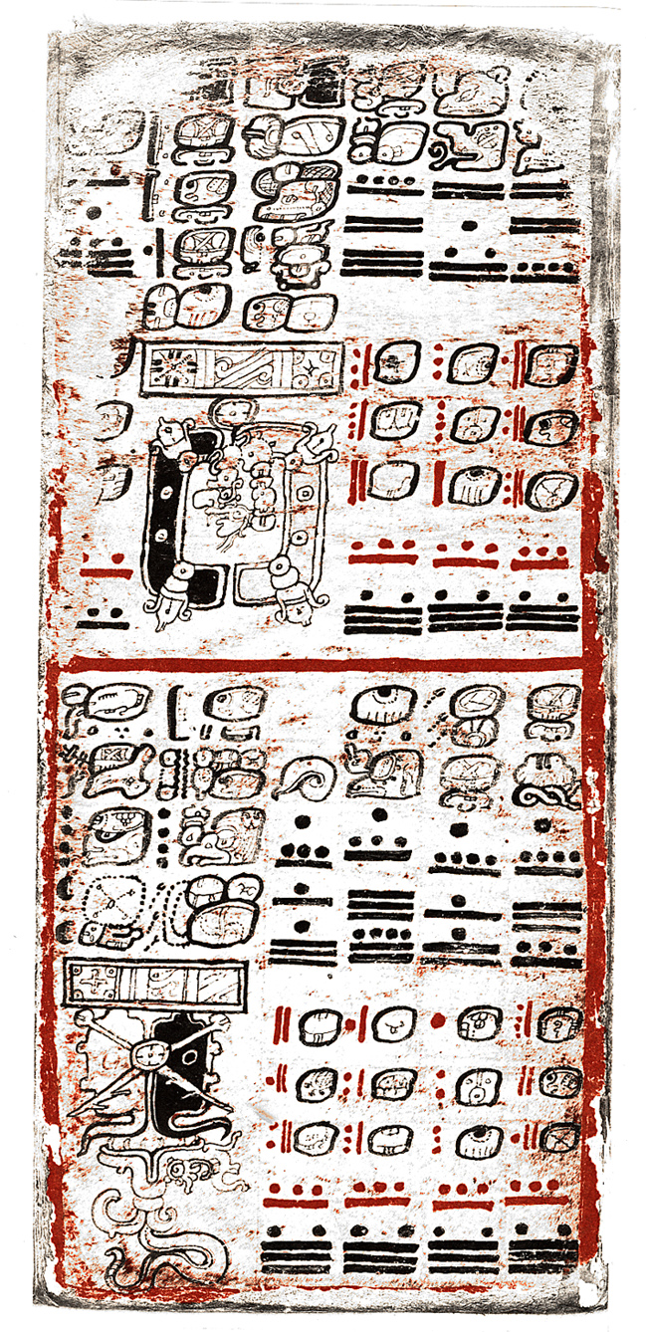
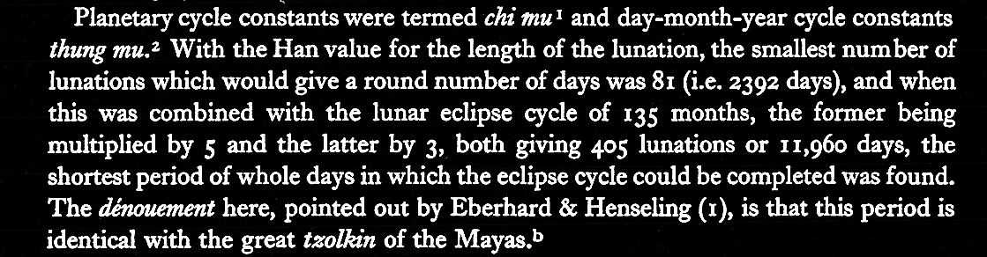
Maya and Han eclipse cycles
Joseph Needham, Science and Civilization in China, 3:407.
1970
Dresden Codex

Slide 37
Across the Seas

Slide 38
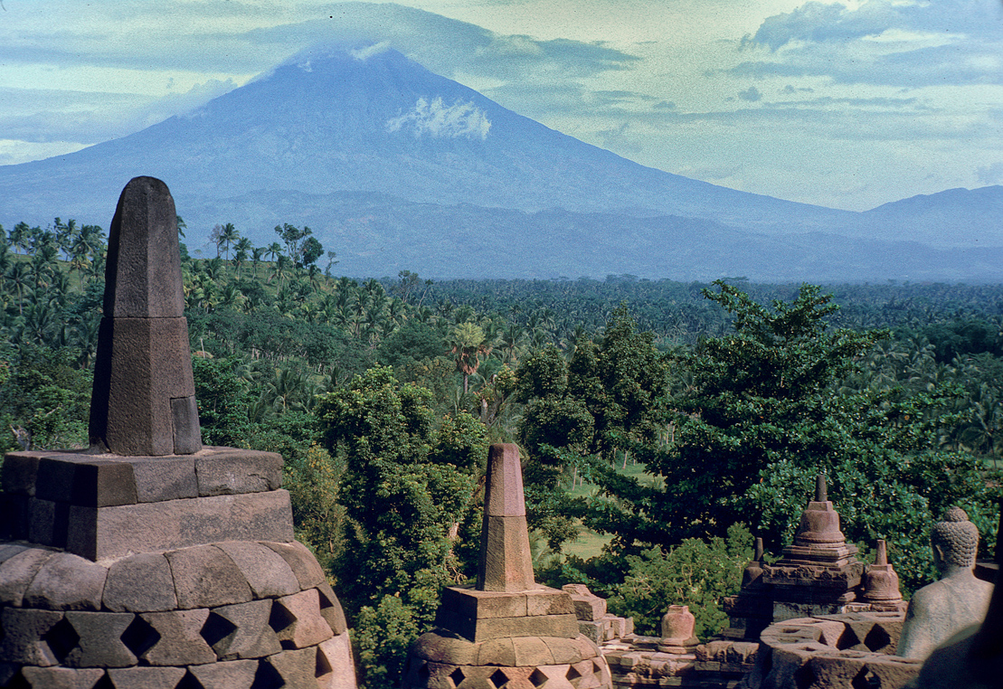

Borobudur, Java. 8th century AD.

Slide 39


Slide 40

Jesperson 2000

Slide 41



Slide 42




Slide 43

“I stand firmly with Gladwin in rejecting the supposition
that these various Asiatic invaders brought with them
to the New World nothing but a repressed desire to
indulge in independent invention, that they came with
culturally empty hands, but brains stuffed full of patents
to be filed only after arrival
I have no use at all for the anthropological
isolationists who are determined to maintain the
incredible dogma that there was no diffusion of
inventions and ideas from the Old World to the new,
but only of naked human animals.”
Earnest A. Hooton
(1887-1954)
(Foreword to Gladwin’s “Men out of Asia”)

